Slide 1
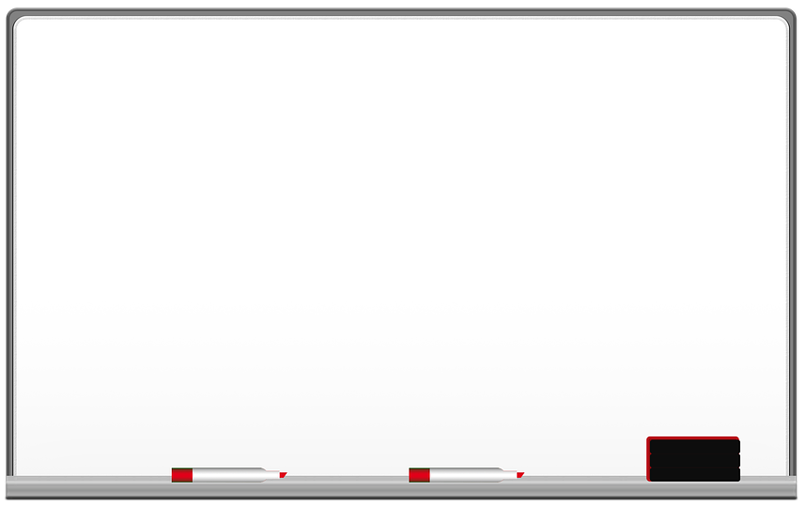
DrawGüd
Ben McDermott, Ronan Gissler, Taylor Korte

Slide 2
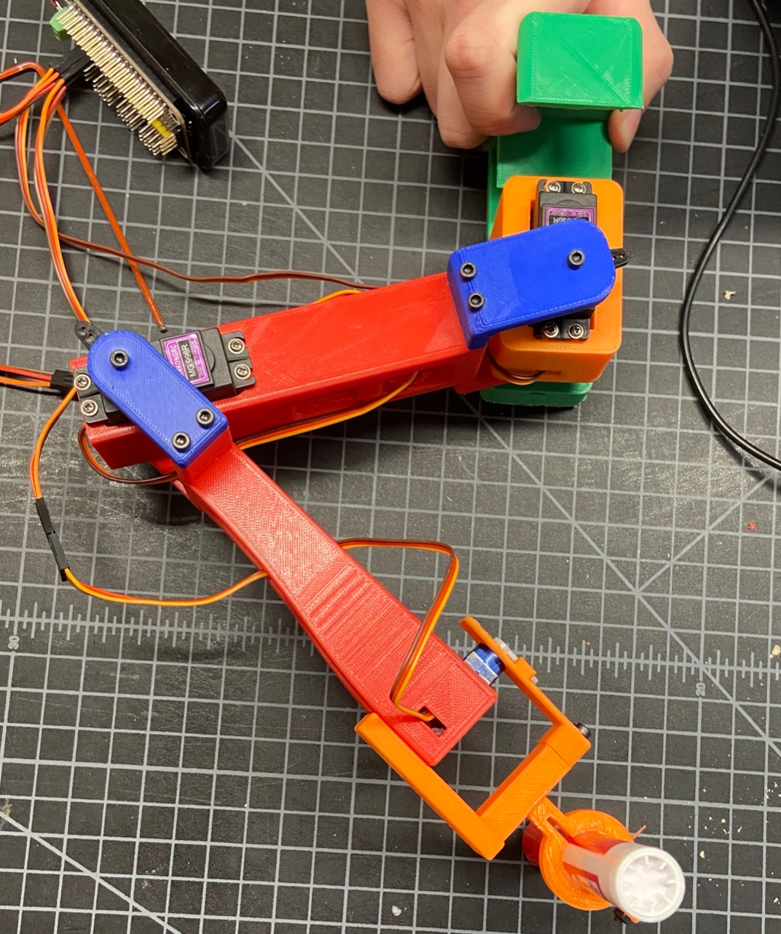
Servo Control and Design Changes
Used the PCA9685 library and linear interpolation to correlate servo angle to pulse width
Redesigned base to better secure to whiteboard and added spots for pi and battery
Changed arm design to accommodate big servo at the elbow joint for higher joint torque
Base
Shoulder
Elbow
Wrist
Ronan

Slide 3
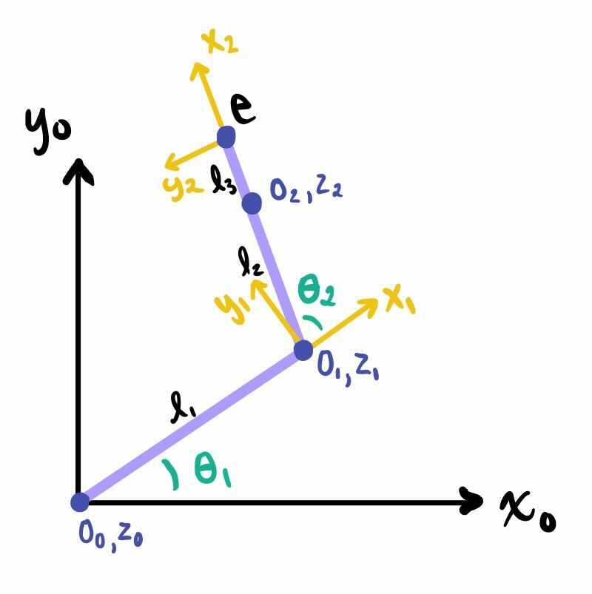
Kinematics
Used the Mathematica template to find the angles for our robot
Converted the Mathematica formulas to Python
Limited the angles by choosing the joint position that is closest to our current joint position
Link # | aᵢ | 𝛼ᵢ | dᵢ | θᵢ
1 | l₁=143.2 | 0 | 0 | θ₁
2 | l₂=139 | 0 | 0 | θ₂
Ben

Slide 4
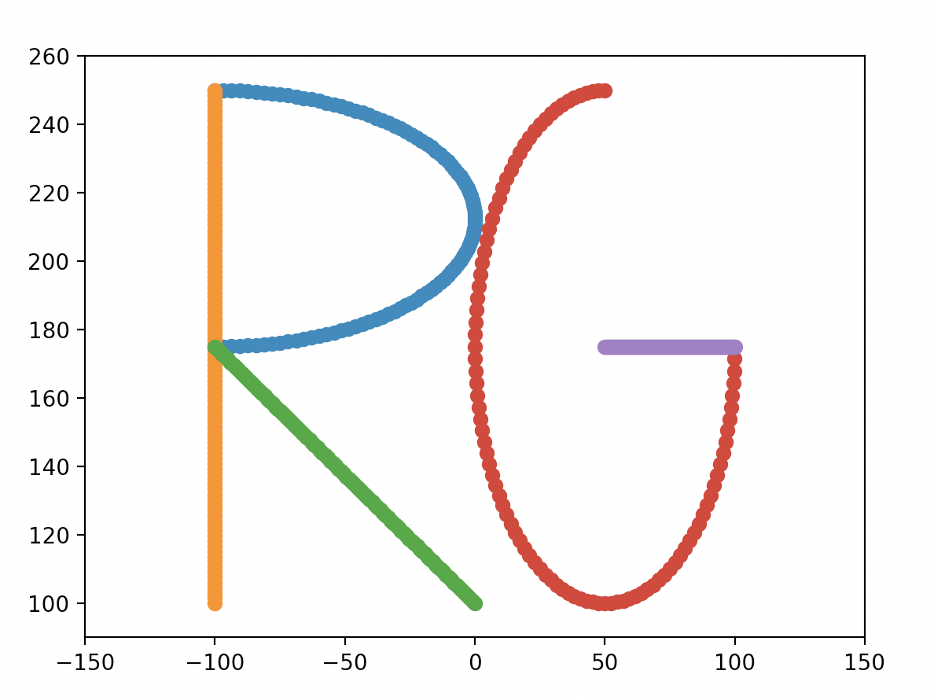
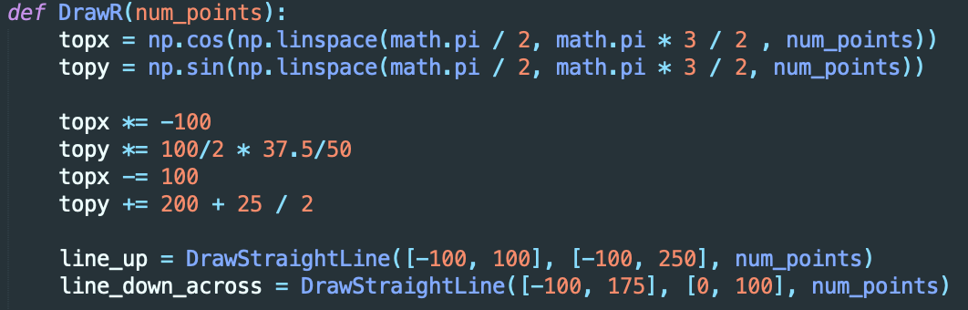
Letter Mapping
Created a function for drawing straight lines by using the numpy function linspace to find equally spaced points between two points
Drew curved lines by scaling and translating the equation of a circle
Scaled the letters to fit into the range of motion of the arm
Taylor

Slide 5
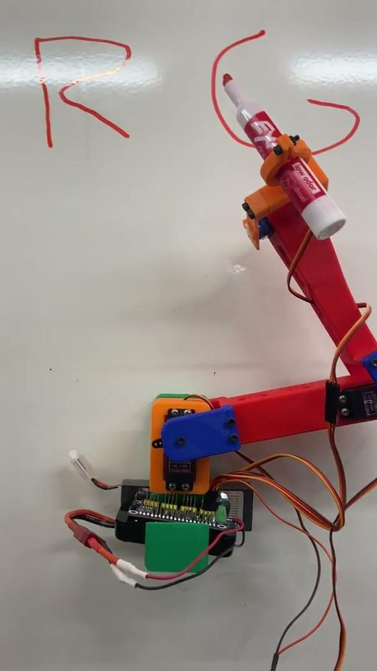
Creativity and Innovation
Used python’s input function to allow the user to type the initials they want the robot to write
Magnets allow robot to be mounted on white board
Wrist joint is used to keep marker pressed to whiteboard and lift marker in between strokes
Colorful!
Taylor

Slide 6

Thanks!

